Slide 1
Fundamentals of Analytical chemistry (221)
COLLEGE OF NATURAL SCIENCE DEPARTMENT OF CHEMISTRY
Course: Industrial Chemistry I (Chem.3121) For Applied Chemistry BSc)
Year III
Lecture 1 Introduction to Industrial Chemistry

Slide 2
Con’t…
Industrial chemistry is a part of chemistry that deals with the Chemical processes
The Chemical processes usually have three interrelated elementary processes
Transfer of reactants to the reaction zone
Chemical reactions involving various unit processes
Separation of the products from the reaction zone using various unit operations
Processes may involve:

Slide 3
Con’t…
Homogeneous system or heterogeneous systems.
Various type reactions involve maybe reversible or irreversible, endothermic or exothermic, catalytic or non-catalytic.
Various variables affecting chemical reactions are temperature pressure, composition, catalyst activity, catalyst selectivity, catalyst stability, catalyst life, the rate of heat and mass transfer.
The reaction may be carried out in batch, semi batch or continuous reactors

Slide 4
Con’t…
Industrial chemistry is a part of chemistry that deals with the:
Development ,
Optimization and
Monitoring of fundamental and chemical products
It deals with the definition of some basic terms, provides you the basic concept of industrial process and industrial variable.
These processes are involved in a wide range of:
applications from environmental protection,
energy conservation to value-adding manufacturing processing.

Slide 5
Con’t…
The processing costs of the unit operations can be broken broadly into four categories:
a) Material costs,
b) Energy costs
c) Capital costs and
d) Miscellaneous costs (labor, taxes, and insurance etc.)
Material and energy costs are the significant proportion of the total cost of production and
Material and energy balances are useful in identifying, quantifying and monitoring the unknown losses.

Slide 6
Con’t…
Industrial process is any operation or series of operations or procedures involving:
Physical,
Chemical,
Electrolysis,
Mechanical steps that aid manufacturing of an item or cause physical or chemical change on a substance.
Thus under certain industrial process:
The raw material can be converted in to useful goods and category products;
These all are done in a large scale industry.

Slide 7
Con’t…
Industrial process require instruments for recording, monitoring and control process variables.
Process variables are variables that characterize the operation process
These variables includes:
Mass,
Volume,
Flow rate,
Concentration,
Pressure and temperature

Slide 8
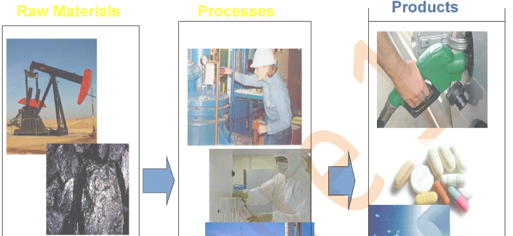
Con’t…
Chemical Engineering is a group of industrial processes in which row materials are changed or separated into useful products.

Slide 9
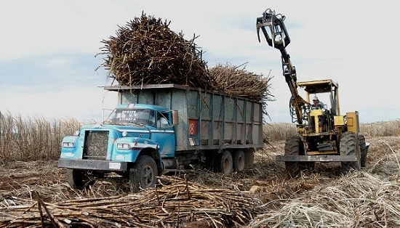
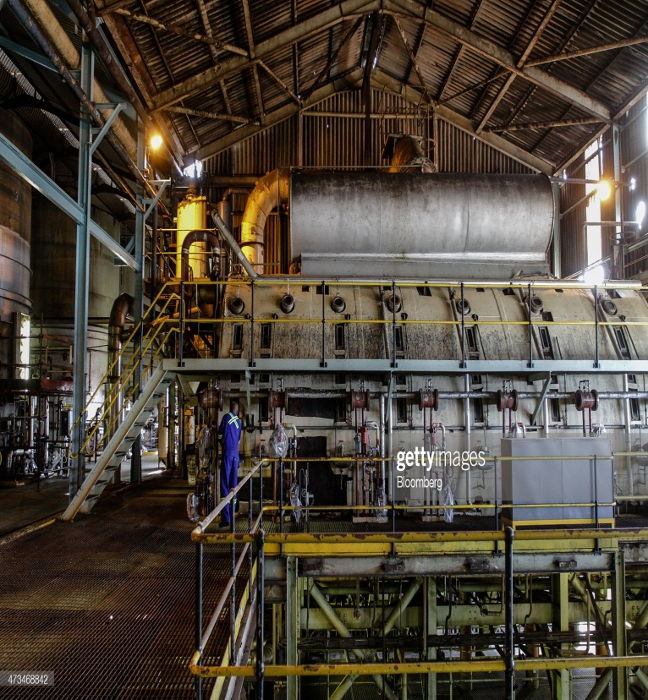
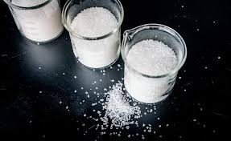
Con’t…
Raw materials Process products

Slide 10
Con’t…
The relationship between Chemistry and Chemical engineering in industrial activity.
Chemistry:
To create a new substance
To study its properties
To investigate all possible pathways from one substance to another
Chemical Engineering:
To design the most optimal technology for production of a specified substance from row materials

Slide 11
Con’t…
A group of industrial processes in which row materials are changed or separated into useful products
To develop and discover new technological applications for materials
Chemical process is combination of unit processes and Unit operation.
Every industrial chemical process is based on Unit Operations (physical treatment) and Unit Process (chemical treatment) to produce economically a desired product from specific raw materials

Slide 12
Con’t…
Unit process involves principle chemical conversions leading to synthesis of various useful product and provide basic information regarding the reaction temperature and pressure, extent of chemical conversions and yield of product of reaction nature of reaction whether endothermic or exothermic, type of catalyst used.
Example of Unit Processes in Chemical Process Industries are:
Alkylation, Decomposition, Acylation Fermentation, Halogenation, Aromatization, Hydrolysis Hydration, Isomerization, Chlorination and Oxy chlorination, Neutralization Condensation, Nitration Oxidation, Polymerization, Dehydrogenation, Sulphonation, Esterification

Slide 13
Con’t…
A unit operation is a basic step in a process.
Unit operations involve a physical change or chemical transformation such as separation, crystallization, evaporation, filtration, polymerization, isomerization, and other reactions.
Unit operations are very important in chemical industries for separation of various products formed during the reaction.
A unit operation is any part of potentially multiple-step process which can be considered to have a single function.
Examples of unit operations include:
Separation/ Purification Processes

Slide 14
Con’t…
Mixing Processes
Power Generation Processes
Heat Exchangers
For example Sugar Manufacture:
Sugar cane crushing →sugar extraction → thickening of syrup →evaporation of water →sugar crystallization →filtration →drying →screening →packing.

Slide 15
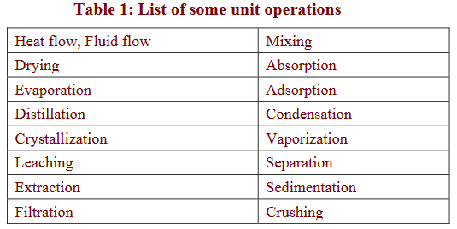
Con’t…
For example, in milk processing, homogenization, pasteurization, and packaging are each unit operations which are connected to create the overall process.

Slide 16
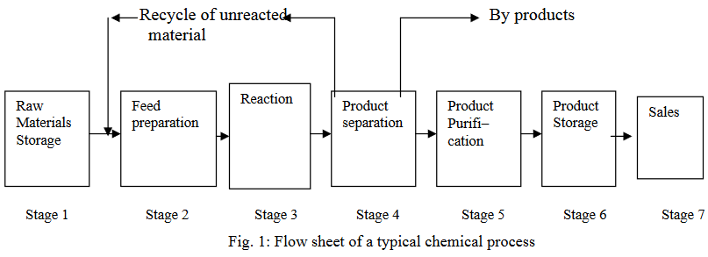
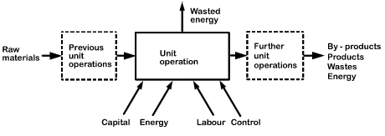
Con’t…
Schematic diagram which illustrates Unit operation in a given industrial activity

Slide 17
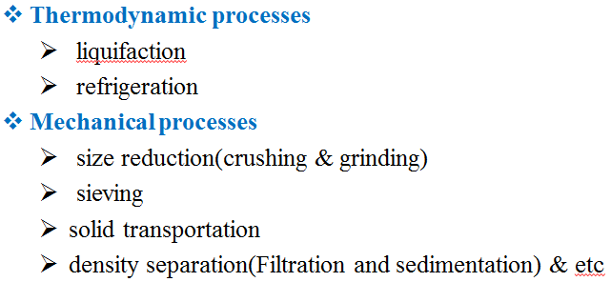
Con’t…
In most of the unit operations encountered in chemical industries the processes of momentum , heat and mass transfer involved.
Heat transfer processes
Conduction, Convection, and Radiation
heating/cooling, diffusion, adsorption, striping
evaporation/condensation
Fluid flow processes
fluid transport
solids fluidization
mixing
Mass transfer processes
absorption
distillation
extraction
adsorption
drying
Diffusion, boiling
Striping, melting

Slide 18
Con’t…
Material Balance and Energy Balance
A mass balance is an accounting of a material for a specific system boundary; which is based on the law of conservation of mass
In other words, we are keeping pathways of:
all sources of the material that enter the system,
all sinks of the material that leave the system, and
all storage of the material within the system
A mass balance can be done for the following situations:
Dynamic (flows change over time)
Steady State (flows do not change over time; the system is in equilibrium

Slide 19
Con’t…
Chemical engineers do a mass balance to account for what happens to each of the chemicals that is used in a chemical process.
The first step in a mass balance analysis is to define the particular region in space that is to be analyzed.
As examples , the region might include anything from:
a simple chemical mixing tank,
an entire coal-fired power plant,
a lake, a stretch of stream,
an air basin above a city, or the globe.

Slide 20
Con’t…
A substance that enters the region has three possible fates:
Some of it may leave the region unchanged
Some of it may accumulate within the boundary
Some of it may be converted to some other substance.
One of the following material balance equation can be written for each substance of interest.
[Input rate]=[output rate]+[Decay rate]+[Accumulation rate]
Notice the decay term doesn’t imply a violation of the law of conservation of mass.
Atoms are conserved, but there is no similar constraint on the chemical reactions, which may change one substance into another

Slide 21
Con’t…
.
1. Steady-state conservative systems
Is one that doesn’t change with time
In these cases the mass balance equation simplifies to:
Input rate= Output rate
2. Steady-state systems with Non conservative pollutants
Many environmental pollutants undergo
chemical,
biological, or
nuclear reactions at a rate sufficient to require us to treat them as nonconservative substances.

Slide 22
Con’t…
If we continue that steady state conditions prevail so that:
the rate of accumulation is zero,
but if the pollutants are nonconservative, the mass balance equation becomes,
Input rate =Output rate + Decay rate
Often the reaction rate is due to biological degradation also known as a decay rate.

Slide 23
Con’t…
Energy Balance
Similar to mass balance, energy quantities can be described by energy balances, which are statements on the conservation of energy.
If there is no accumulation, what goes into a process must come out; this is true for batch operation.
It is equally true for continuous operation over any chosen time interval.
Energy takes many forms, such as:
heat, kinetic energy, chemical energy, potential energy but because of inter-conversions it is not always to isolate/separate constituents of energy balances

Slide 24
Con’t…
Energy balances can be calculated on the basis of:
external energy used per kilogram of product,
or raw material processed,
or on dry solids or some key component.
The energy consumed in food production includes:
direct energy which is fuel and electricity used on the farm, and in transport and in factories, and in storage, selling, etc; and
indirect energy which is used to actually build the machines, to make the packaging, to produce the electricity and the oil and so on.

Slide 25
Con’t…
Food itself is a major energy source, and energy balances can be determined for animal or human feeding;
food energy input can be balanced against outputs in heat and mechanical energy and chemical synthesis.
Generally, material and energy balances are very important in an industry
These are fundamental to the control of processing, particularly in the control of yields of the products.

Slide 26
Con’t…
Material quantities, as they pass through processing operations, can be described by material balances.
Such balances are statements on the conservation of mass; just as mass is conserved, so is energy.
The energy coming into a unit operation can be balanced with the energy coming out and the energy stored.
Heat entering=Heat leaving

Slide 27
Con’t…
Material and energy balances can be worked out quantitatively knowing the amounts of materials entering into a process, and the nature of the process.
Material and energy balances take the basic form
Content of inputs = content of products + wastes/losses + changes in stored materials
3. In continuous processes, a time balance must be established.
4. Energy includes heat energy (enthalpy), potential energy (energy of pressure or position), kinetic energy, work energy, chemical energy.
It is the sum over all of these that is conserved

Slide 28
Con’t…
Material and energy balances can be worked out quantitatively knowing the amounts of materials entering into a process, and the nature of the process.
Material and energy balances take the basic form
Content of inputs = content of products + wastes/losses + changes in stored materials
3. In continuous processes, a time balance must be established.
4. Energy includes heat energy (enthalpy), potential energy (energy of pressure or position), kinetic energy, work energy, chemical energy.
It is the sum over all of these that is conserved

